Slide 1
Week 9 Presentation
By J. Jedediah Smith

Slide 2
What was tried?
Reworked the FastQC and FastP example scripts to run with test data.
Wrote out the code to set up and use each classifier in the own documents in preparation for testing.
Practiced setting up conda environments as explained in notes.
Attempted to set up environments with the programs I needed to run
Tried to download reference databases for said programs.

Slide 3
How did it go?
FastQC worked and I was able to download and view the quality report on my computer.
Doesn’t appear to trim data, so tried FastP.
FastP program did not work and gave an error I wasn’t able to debug.
I ran into problems with conda, as it appears to always load from the BIODATA directory instead of the root/anaconda3 node. Was unable to run any of the programs I needed.
Reached out to Rob about it and awaiting response.

Slide 4
Where to go next?
Need to get the programs running on the server before I can proceed with the bulk of my project.
Explore tools to trim the data rather than just present a report.
Run test data through the cloud-based long read classifier BugSeq. This is not dependent on the server so I should be able to experiment with it in the meantime.

Slide 5
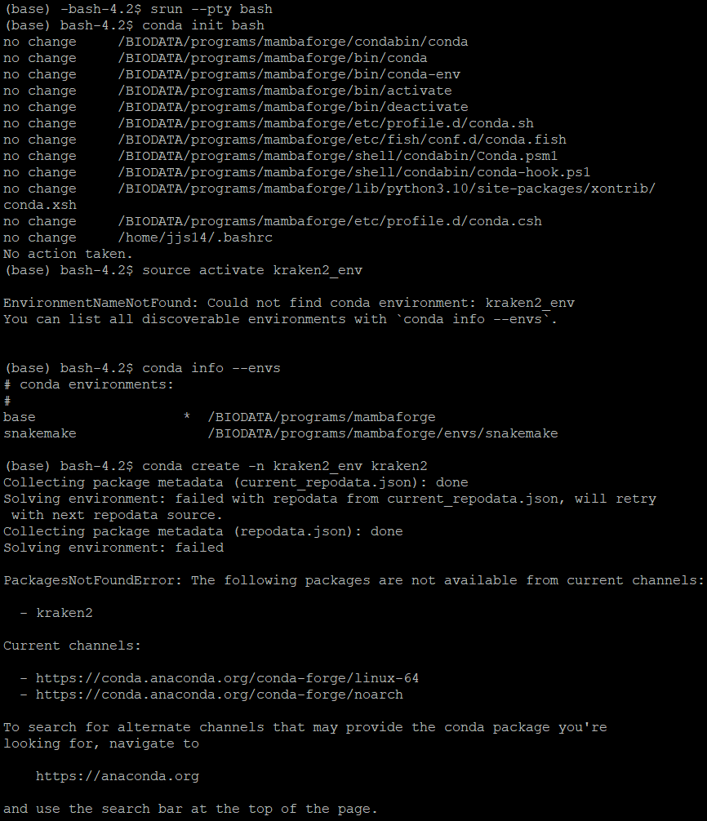
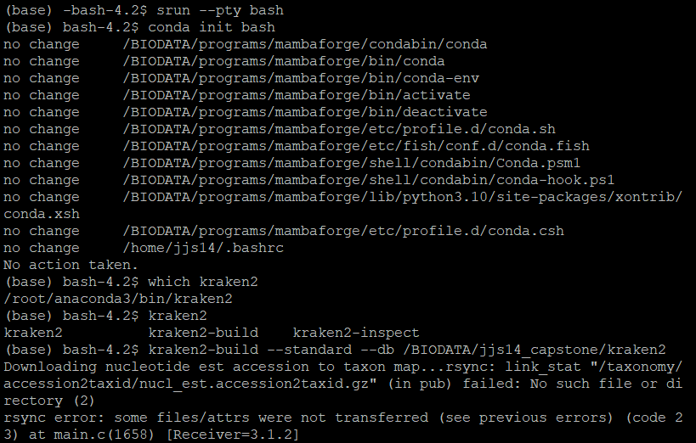
Kraken 2 Errors

